Slide 1

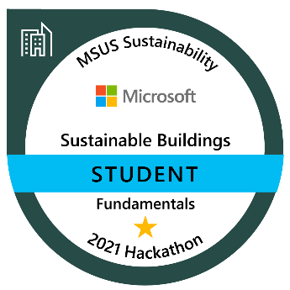
Sustainable Smart Buildings Hackathon
INCREASE KNOWLEDGE
BUILD SUSTAINABLE SOLUTIONS
FORM A COMMUNITY
Build your knowledge around sustainable smart buildings solutions and earn your badge in this hackathon on [Date].
Develop Proof of Concepts (POC) to address today’s most pressing issues to help reach sustainability goals.
Join a community of sustainability champions to learn best practices and share knowledge to build sustainable ecosystem solutions.
Help shape the future of sustainable buildings technology
PARTICIPANT PREREQUISTITES
Experience in Python
Background in machine learning modeling
Purpose
Drive sustainability fluency among the technical sales teams to build repeatable and customizable 1st party solutions for environmental monitoring, energy consumption, facility operating efficiency, and energy source optimization.
GIVES
Commitment to participate in up to four challenges over a three-day event (8 hours each day)
Share best practices related to sustainable smart buildings technology
Help to shape sustainability hackathons and skilling programs
GETS
Participate in the community of Microsoft Sustainability champions and drive strategy
Earn fundamental badge certification in Sustainable Smart Buildings
Gain deeper knowledge of technical scenarios related to the ecosystems of sustainable technology
Opportunity to increase your proficiency in Azure Blob Storage, data exploration, IoT Sensor data, and more
Hackathon resources
SharePoint site
Sustainable Smart Buildings Hack FAQ
HACKATHON OUTCOMES
Programmatic up-skilling motion
Develop POC 1st party solutions
REGISTRATION SITE
Badging gamification

